Slide 1
Models for Understanding and Controlling Global Infectious Diseases HUMBIO 154D / HRP 204
Session 6
Jason Andrews
Jeremy Goldhaber-Fiebert
2020

Slide 2
Course Roadmap
First Models
SIR models with demography
Reproductive Number, Thresholds, Equilibria
Lab: Dynamic Models in R
Heterogeneous mixing and temporal modeling
Emerging infections: takeoff, growth, extinction
Lab: Emerging infections
Vectors, zoonoses, & environmental transmission
Stochastic dynamics
Spatial models, networks
Interventions and sensitivity analyses
Lab: Interventions and sensitivity analyses
Competition and evolutionary models
Within host evolution
Lab on Parameterization, calibration, and uncertainty
Health policy and economic evaluation models
Uses and abuses of models

Slide 3
Practical Questions
How does heterogeneity (stratifying our model by subgroups) affect its prediction about spread of disease and equilibria? About effects of interventions?
In addition to the reasons we discussed last time for oscillations in endemic equilibria to occur for SIR models with demographics, are there other reasons for oscillations? How do these interact? Can they help us explain observed patterns?

Slide 4
Learning Objectives
Describe how and why structured models have different equilibria from otherwise similar unstructured models
Differentiate between structured and age-stratified models
Define what a contact matrix is and describe several ways (and their pros and cons) for estimating them from data and/or theory
Explain how seasonal forcing may arise
Understand why seasons forcing can amplify or damp oscillations in an SIR model with demography
Enumerate other types of patterns that might emerge in such situations
Interpret bifurcation diagrams

Slide 5
RISK GROUPS

Slide 6
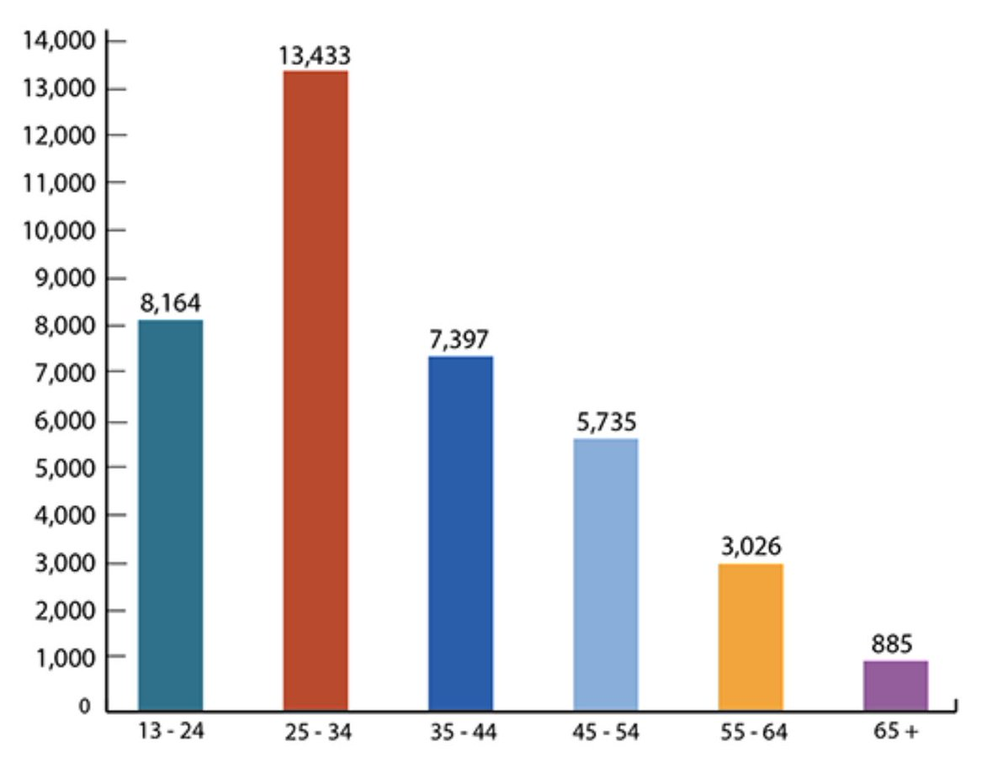
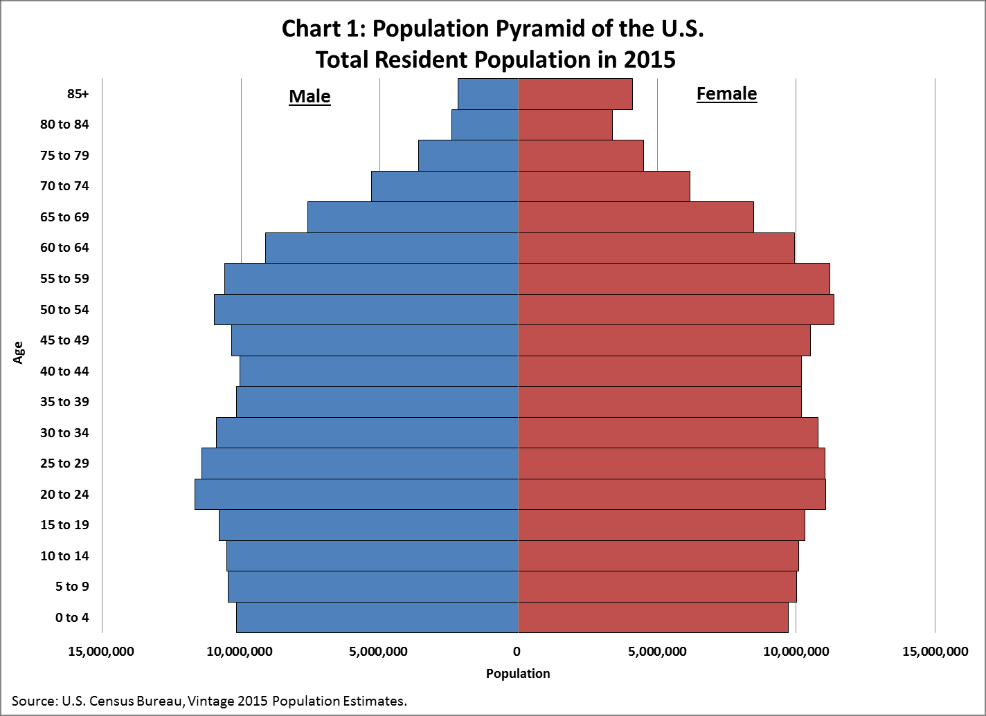
New HIV Diagnoses in the US and Dependent Areas by Age, 2018
https://www.cdc.gov/hiv/statistics/overview/ataglance.html; https://www.census.gov/newsroom/blogs/random-samplings/2016/06/americas-age-profile-told-through-population-pyramids.html

Slide 7
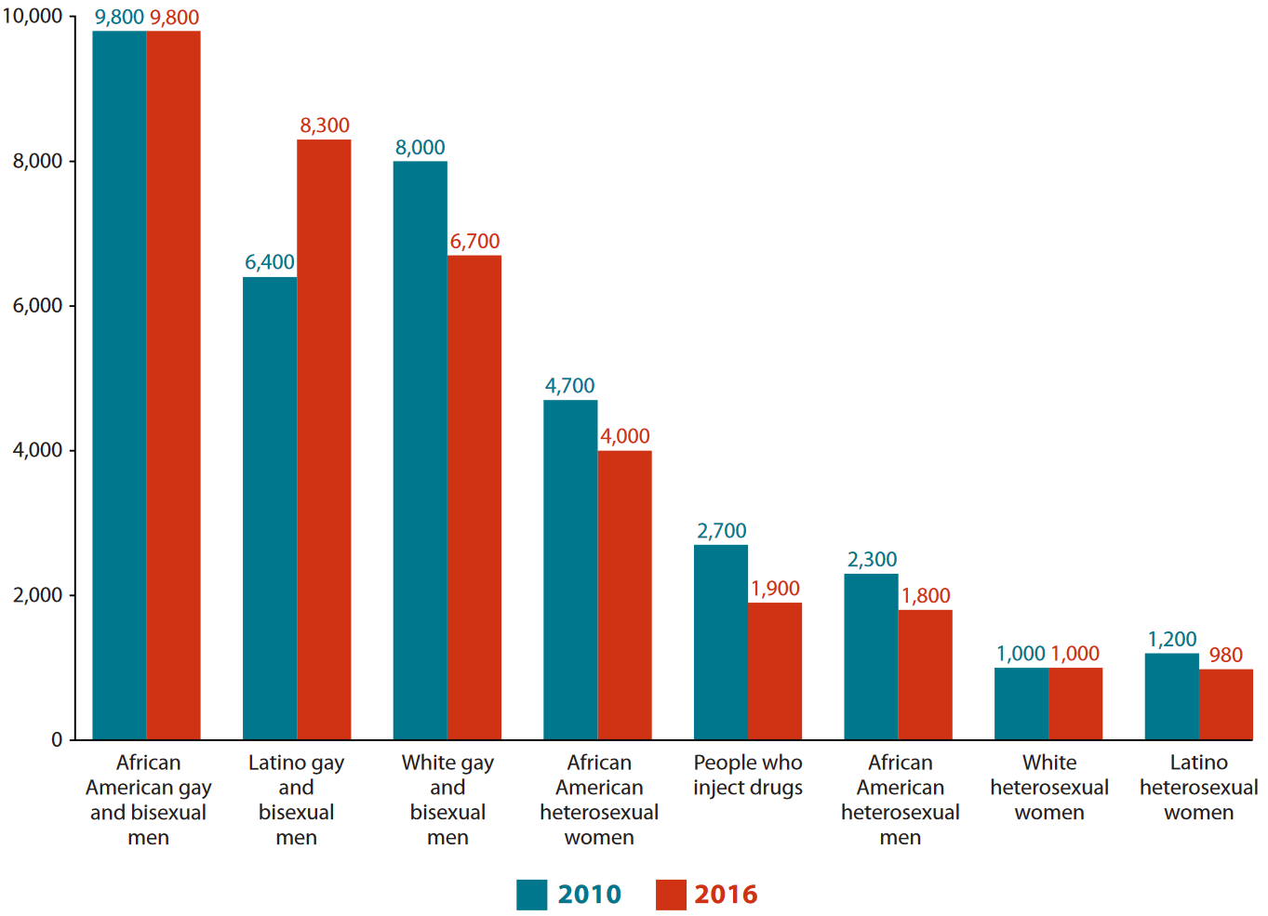
New HIV Infections by Race and Transmission Group, U.S. 2010 vs. 2016
How do we identify high risk groups?
https://www.hiv.gov/hiv-basics/overview/data-and-trends/statistics

Slide 8


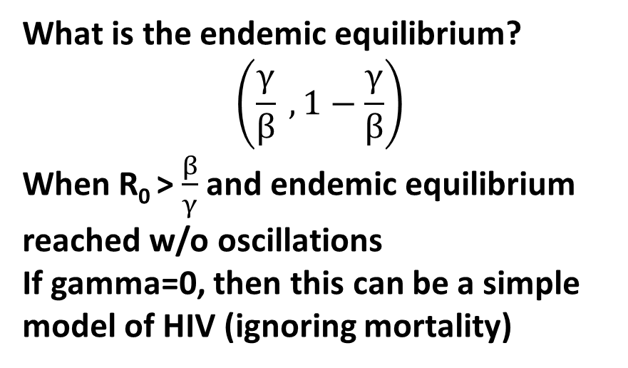
Remember: Unstratified SIS Models
S
βI
I
γ
$$\frac{dS}{dt}=γI−βSI$$
What is the endemic equilibrium?
$$\left(\frac{γ}{β} , 1−\frac{γ}{β}\right)$$
When R₀ > $\frac{β}{γ}$ and endemic equilibrium reached w/o oscillations
If gamma=0, then this can be a simple model of HIV (ignoring mortality)
$$\frac{dI}{dt}=βSI−γI$$

Slide 9
Simplest Stratified SIS Models
γ
S_{L}
I_{L}
βI
S_{H}
βI
I_{H}
γ
Note that in this model risk group membership does not change (Hs remain Hs and Ls remain Ls)

Slide 10
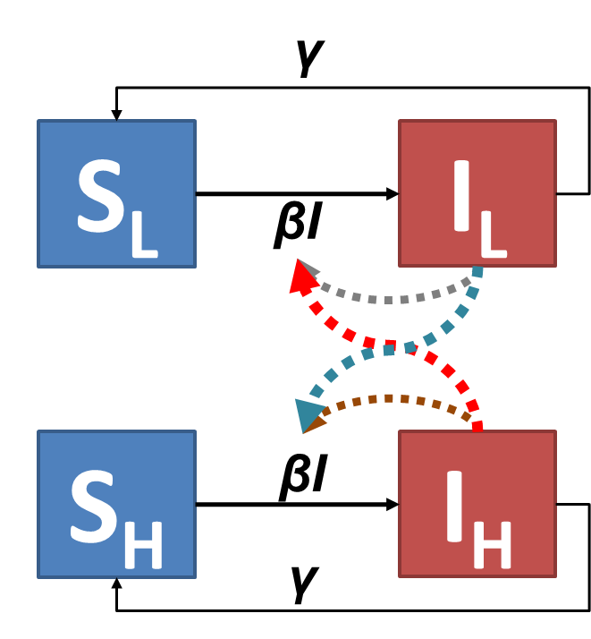
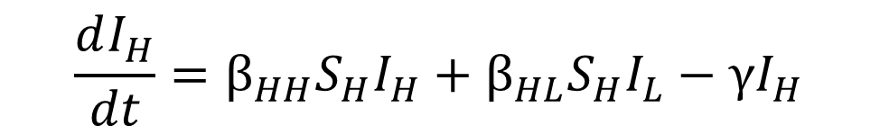
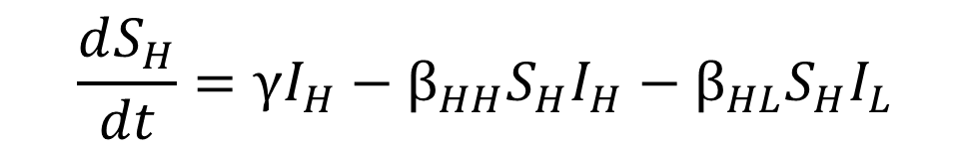
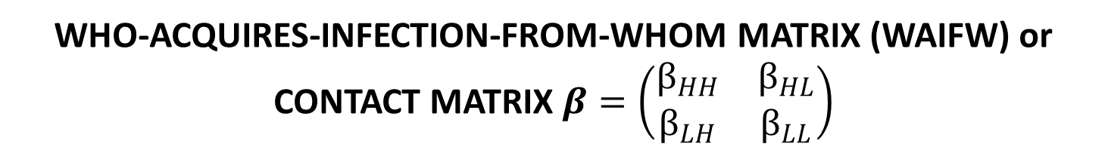
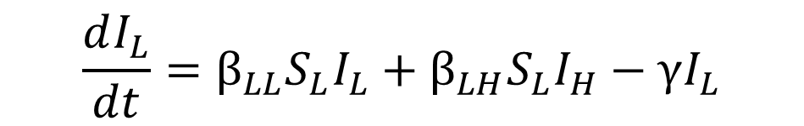
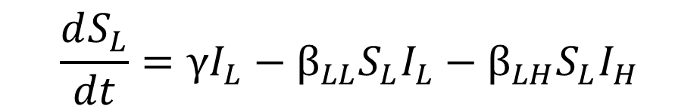
Simplest Stratified SIS Models
$$\frac{dS_{L}}{dt}=γI_{L}−β_{LL}S_{L}I_{L}−β_{LH}S_{L}I_{H}$$
$$\frac{dI_{L}}{dt}=β_{LL}S_{L}I_{L}+β_{LH}S_{L}I_{H}−γI_{L}$$
$$\frac{dS_{H}}{dt}=γI_{H}−β_{HH}S_{H}I_{H}−β_{HL}S_{H}I_{L}$$
$$\frac{dI_{H}}{dt}=β_{HH}S_{H}I_{H}+β_{HL}S_{H}I_{L}−γI_{H}$$
WHO-ACQUIRES-INFECTION-FROM-WHOM MATRIX (WAIFW) or CONTACT MATRIX $β=\left(\begin{matrix}β_{HH} & β_{HL} \\ β_{LH} & β_{LL}\end{matrix}\right)$
Notes:
Note: the equations for dIl/dt and dIh/dt have been updated since the version in lecture

Slide 11
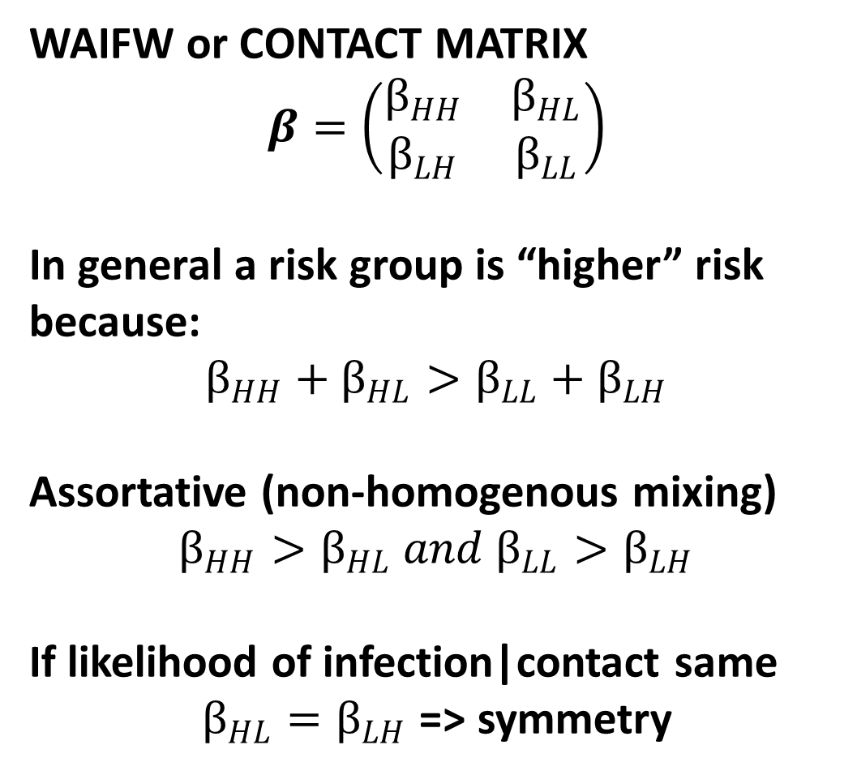
Simplest Stratified SIS Models
WAIFW or CONTACT MATRIX
$$β=\left(\begin{matrix}β_{HH} & β_{HL} \\ β_{LH} & β_{LL}\end{matrix}\right)$$
In general a risk group is “higher” risk because:
$$β_{HH}+β_{HL}>β_{LL}+β_{LH}$$
Assortative (non-homogenous mixing)
$$β_{HH}>β_{HL} and β_{LL}>β_{LH}$$
If likelihood of infection|contact same
$β_{HL}=β_{LH}$ => symmetry

Slide 12
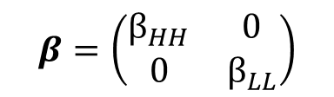
Implications of Risk Stratification
γ
S_{L}
I_{L}
βI
S_{H}
βI
I_{H}
γ
Imagine we have our model but without the interactions across the groups
$$β=\left(\begin{matrix}β_{HH} & 0 \\ 0 & β_{LL}\end{matrix}\right)$$

Slide 13
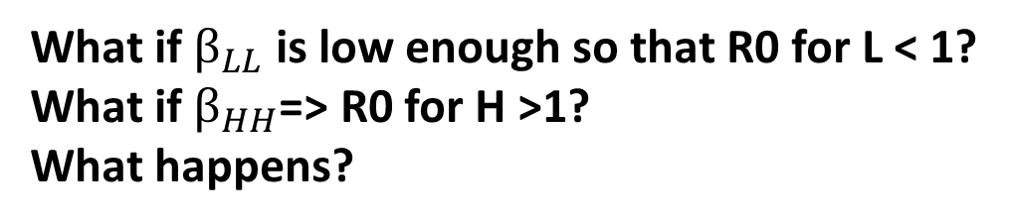
Implications of Risk Stratification
γ
S_{L}
I_{L}
βI
S_{H}
βI
I_{H}
γ
What if $β_{LL}$ is low enough so that R0 for L < 1?
What if $β_{HH}$=> R0 for H >1?
What happens?
$$β=\left(\begin{matrix}β_{HH} & 0 \\ 0 & β_{LL}\end{matrix}\right)$$

Slide 14
Implications of Risk Stratification
No endemic equilibrium in the L subgroup
So if a few I’s were imported into the L subgroup their prevalence would decline over time to 0
An endemic equilibrium in the H subgroup

Slide 15
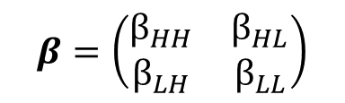
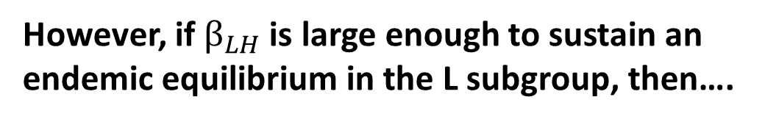
Implications of Risk Stratification
γ
S_{L}
I_{L}
βI
S_{H}
βI
I_{H}
γ
However, if $β_{LH}$ is large enough to sustain an endemic equilibrium in the L subgroup, then….
$$β=\left(\begin{matrix}β_{HH} & β_{HL} \\ β_{LH} & β_{LL}\end{matrix}\right)$$

Slide 16
Implications of Risk Stratification
Initial Phase
Slaved Phase
Equilibrium Phase
Infected
H SUBGROUP
L SUBGROUP
Time

Slide 17
Implications of Risk Stratification
Initial Phase: L subgroups dynamics behave similarly to if there were not interactions between subgroups (b/c not so many infected H people yet); H grows in size.
Slaved Phase: Growth in both groups is drive primarily by the “dominant” group’s dynamics, other subgroups become synchronized or slaved (see Eigenvalue approach in Box 3.10)
Equilibrium Phase: Reached because the dominant group’s prevalence stops growing

Slide 18
Implications of Risk Stratification
For stratified models like these, the Initial Phase (whether there is rise or fall) and ultimately where the system goes depends both on R0s and on initial conditions (amount of infectious individuals in each subgroup at time 0)
Initial Phase: L subgroups dynamics behave similarly to if there were not interactions between subgroups (b/c not so many infected H people yet); H grows in size.
Slaved Phase: Growth in both groups is drive primarily by the “dominant” group’s dynamics, other subgroups become synchronized or slaved (see Eigenvalue approach in Box 3.10)
Equilibrium Phase: Reached because the dominant group’s prevalence stops growing
Stratified models can sustain an endemic equilibrium with relatively low levels of overall prevalence (higher fraction of H subgroup infected though) as they have higher R0s than otherwise similar unstructured models (harder to achieve complete eradication)

Slide 19
Control Measures in Stratified Models
In an unstructured SI model, an intervention like vaccination transforms it into an SIR model (vaccinated people are immune like recovered people but without having been sick)
The one decision to make is what fraction of the population to vaccinate for optimal control
S
βI
I
R
Vax

Slide 20
Control Measures in Stratified Models
In a structured SI model, interventions like vaccination have two important, related decision
What fraction of the population to vaccinate for optimal control (like the unstructured model)
How targeted should the intervention be (what proportion of those vaccinated should be recruited from the L subgroup and what fraction from the H subgroup)

Slide 21
Which group should be target and why?
Infected
H SUBGROUP
L SUBGROUP
Targeting the H subgroup generally has a bigger effect for a given level of vaccination coverage because it drives epidemic growth.
Time

Slide 22
REVISITING CONTACT MATRICES

Slide 23
How do we estimate contact matrices?
As we have more input parameters (2 risk groups => 4 Betas) than in a non-stratified model, we need to think about where this data comes from and strategies for dealing with incomplete (but needed) data
For n risk groups, we require n² Betas

Slide 24
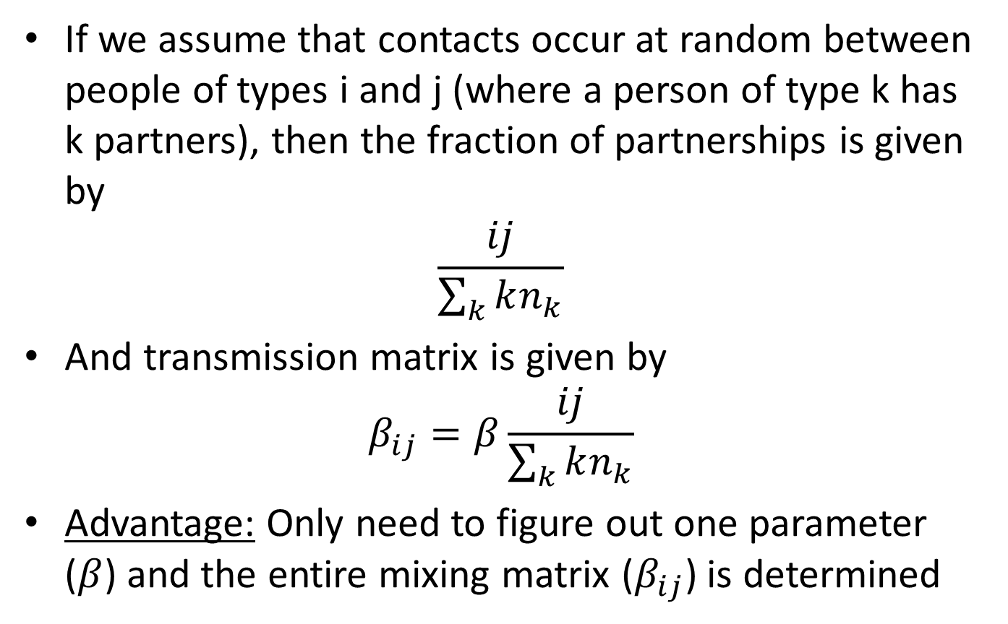
One Strategy: Random Partnership Model
If we assume that contacts occur at random between people of types i and j (where a person of type k has k partners), then the fraction of partnerships is given by
$$\frac{ij}{\sum_{k}{kn_{k}}}$$
And transmission matrix is given by
$$β_{ij}=β\frac{ij}{\sum_{k}{kn_{k}}}$$
Advantage: Only need to figure out one parameter ($β$) and the entire mixing matrix ($β_{ij}$) is determined

Slide 25
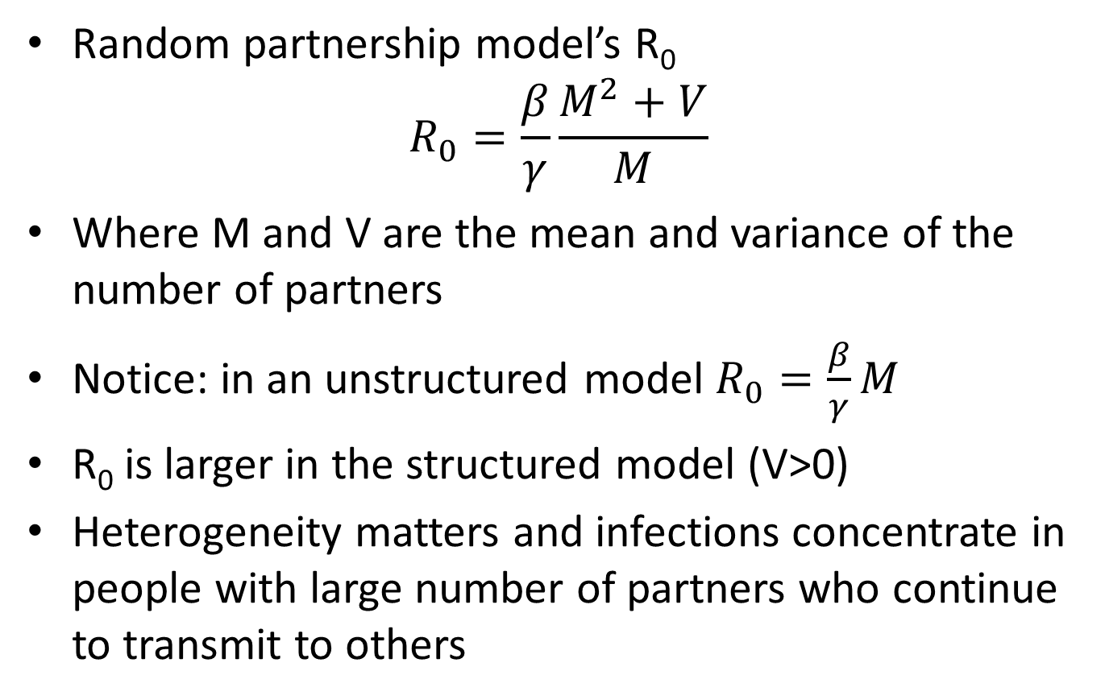
One Strategy: Random Partnership Model
Random partnership model’s R₀
$$R_{0}=\frac{β}{γ}\frac{M^{2}+V}{M}$$
Where M and V are the mean and variance of the number of partners
Notice: in an unstructured model $R_{0}=\frac{β}{γ}M$
R₀ is larger in the structured model (V>0)
Heterogeneity matters and infections concentrate in people with large number of partners who continue to transmit to others

Slide 26
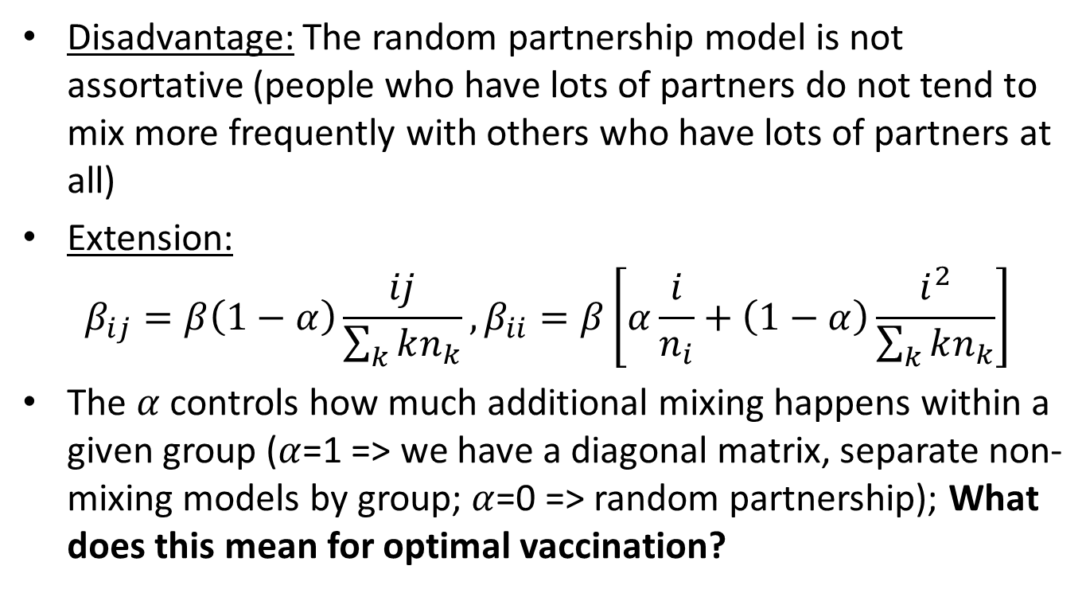
One Strategy: Random Partnership Model
Disadvantage: The random partnership model is not assortative (people who have lots of partners do not tend to mix more frequently with others who have lots of partners at all)
Extension:
$$β_{ij}=β\left(1−α\right)\frac{ij}{\sum_{k}{kn_{k}}},β_{ii}=β\left[α\frac{i}{n_{i}}+\left(1−α\right)\frac{i^{2}}{\sum_{k}{kn_{k}}}\right]$$
The $α$controls how much additional mixing happens within a given group ($α$=1 => we have a diagonal matrix, separate non-mixing models by group; $α$=0 => random partnership); What does this mean for optimal vaccination?
Notes:
Note: the equation for B_ii has been updated from the version shown in lecture.

Slide 27
Another Strategy: Survey Methods
If we want to establish mixing patterns empirically, one approach is to survey people about their behaviors/contacts
Advantage: do not have to make assumptions about how mixing occurs (or at least we can make assumptions consistent with what we observe)
Two main types of surveys:
Surveys that attempt to establish contact networks (more appropriate for sexual mixing or shared injection drug use but much more intensive and sampling harder)
Surveys that measure #s of contacts (not networks) (more appropriate for respiratory contacts for example)

Slide 28
Another Strategy: Survey Methods: Sampling the Network
Consider the case of a sexual mixing network
We ask people for a list of partners
We then go to their partners and get a list of their partners, etc….
We can eventually reconstruct a connected graph (network) and characterize things like:
What is the distribution of the number of partners people have
Do the partners of people with more partners tend to have more partners themselves

Slide 29
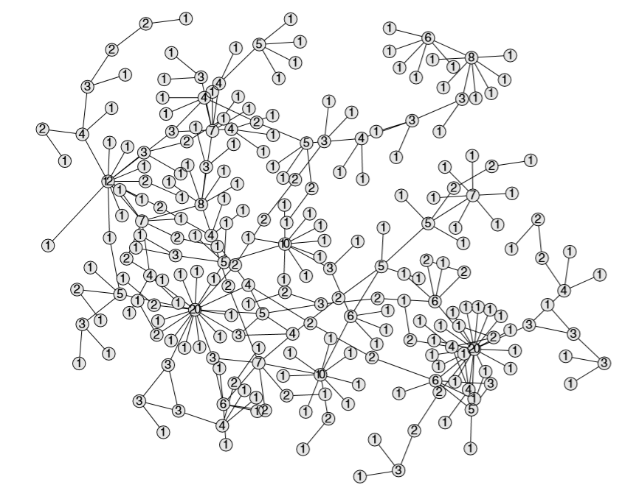

Slide 30
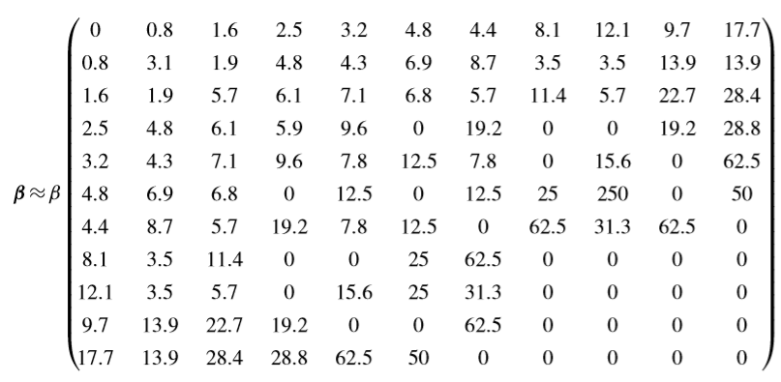
Rows (i) represent people with 1, 2, 3, …, 9, 10, 12, and 20 partner
Columns (j) represent whether the partners are people with 1, 2,…,10,12, or 20 partners themselves
Entries are proportionate to number of i-j partnerships divided by the product of the number of people of type i and number of people of type j (when will this be large?)

Slide 31
Another Strategy: Survey Methods: Large-Scale Frequency/Intensity Surveys
Mossong et al. Social contacts and mixing patterns relevant to the spread of infectious diseases. PLoS Medicine, 2008.
Information on social contacts from cross-sectional surveys in 8 European countries
Participants were recruited to be representative of the population in terms of geographical spread, age, and sex

Slide 32
Another Strategy: Survey Methods: Large-Scale Frequency/Intensity Surveys
Diaries recorded basic sociodemographic and household information. Participants were assigned a random day of the week to record every person they had contact with for 24 hours starting at 5 A.M.
Participants recorded contacted individuals only once in the diary (defined as either skin-to-skin contact or a two-way conversation of at least minimal duration).
Participants provided age and sex of each contact

Slide 33
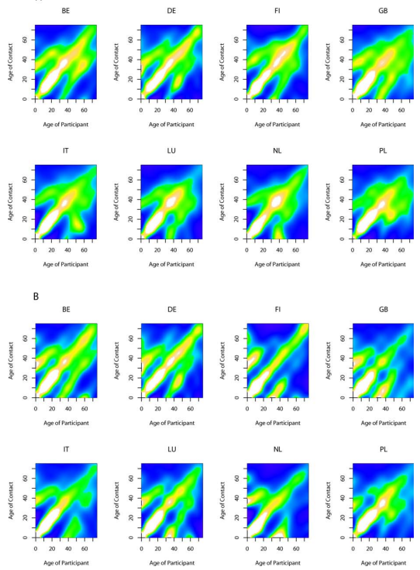
How do we expect infections to spread throughout age groups if the first is in a 10 year-old?
Which group will dominate the dynamics of growth during the slaved phase and why?

Slide 34
AGE-STRUCTURED MODELS SIMILAR TO BUT DIFFERENT TO RISK STRUCTURED MODELS

Slide 35
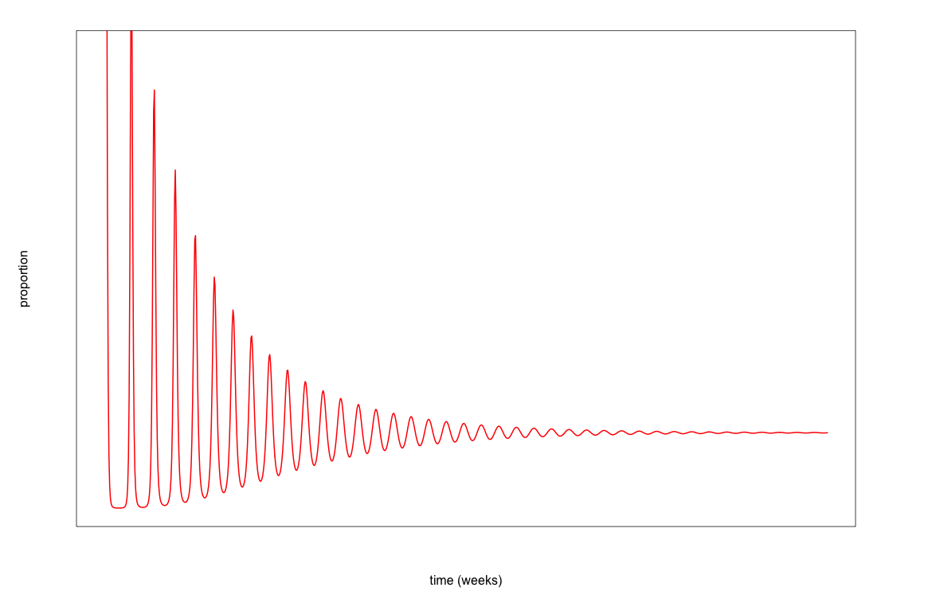
SIR model with demography: Damped Oscillatory Dynamics

Slide 36
Remember: In the Stratified Models, People Stay in Their Original Risk Group
γ
S_{L}
I_{L}
βI
S_{H}
βI
I_{H}
γ
Note that in this model risk group membership does not change (Hs remain Hs and Ls remain Ls)

Slide 37
Remember: In the Stratified Models, People Stay in Their Original Risk Group
γ
S_{L}
I_{L}
βI
In Age-Structured Models, people in one age group change to the next age group in a predictable way (Except if the period being modeled is much shorter than the “width” of the age group
S_{H}
βI
I_{H}
γ
Note that in this model risk group membership does not change (Hs remain Hs and Ls remain Ls)

Slide 38
Age-Structured Model of Children (C) and Adults (A): Like Stratified Models but with Aging
γ
S_{C}
I_{C}
βI
S_{A}
βI
I_{A}
γ

Slide 39
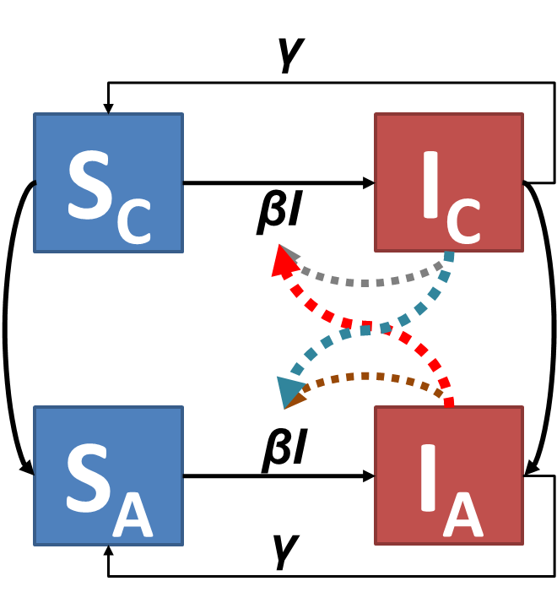
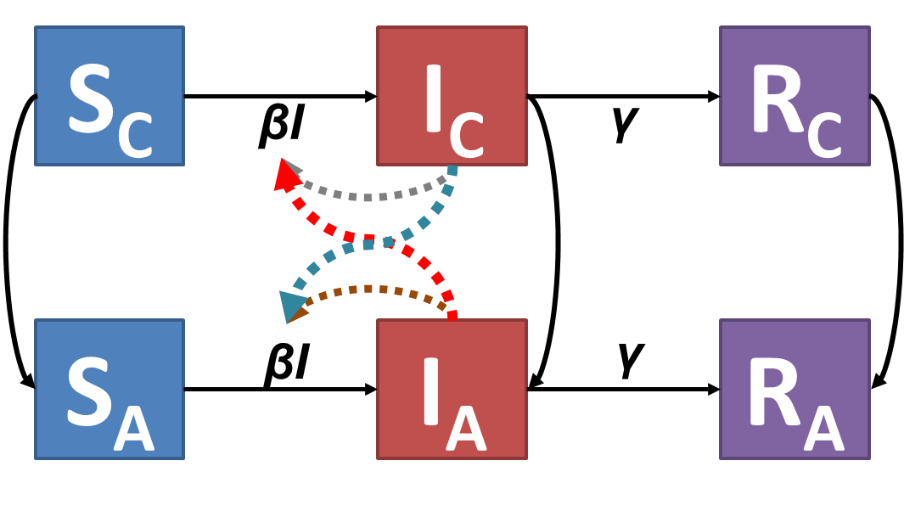
How will the age patterns of a serosurvey differ for an Age-Structured SIS vs. an Age-Structured SIR Model? Why? What if there is waning immuninty?

Slide 40
Age-Structured Model of Children (C) and Adults (A): Like Stratified Models but with Aging
S_{C}
I_{C}
R_{C}
βI
γ
S_{A}
βI
I_{A}
γ
R_{A}

Slide 41
FIXED AND TIME-VARYING MODEL PARAMETERS

Slide 42
Remember: SIR model with demography have Damped Oscillatory Dynamics if their endemic equilibria are feasible
S
βI
I
γ
R
µ
µ
µ
µ

Slide 43
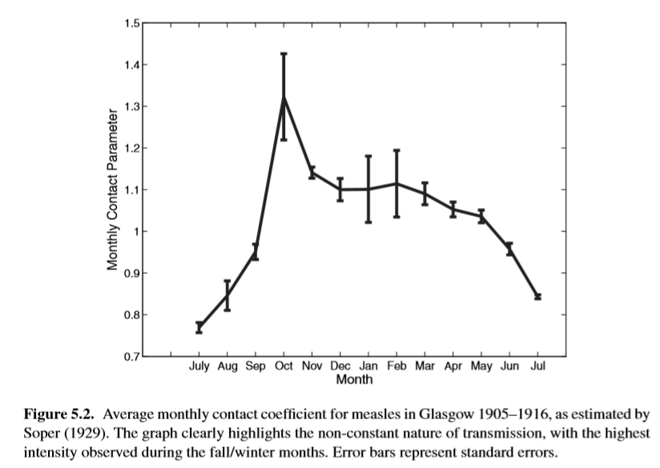
Seasonal variation in contacts

Slide 44
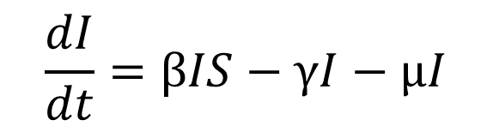
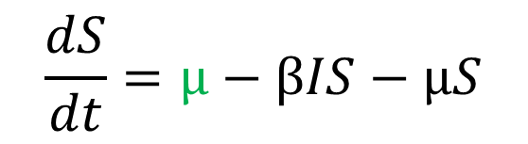

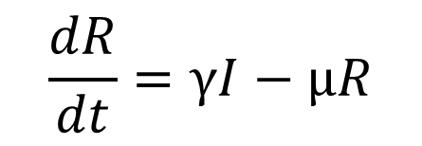
Define contacts as oscillating over time
$β=β_{0}\left(1+β_{1}cos\left(ωt\right)\right), where$ $0≤β_{1}≤1$
$$\frac{dS}{dt}=μ−βIS−μS$$
$$\frac{dI}{dt}=βIS−γI−μI$$
$$\frac{dR}{dt}=γI−μR$$

Slide 45

Overall oscillations bigger when forcing (the push) happens in (near) synchrony with the frequency of the underlying oscillation

Slide 46
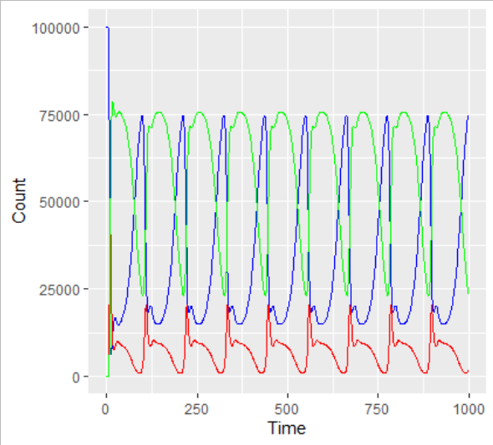
Complicated dynamics can emerge: The combination of damped oscillation and the seasonal forcing oscillation

Slide 47
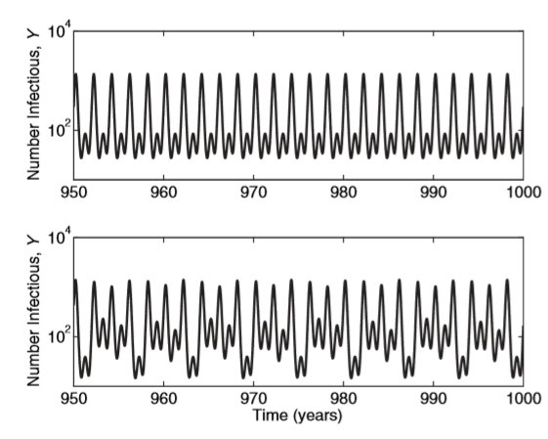
Complicated dynamics can emerge: They also depend on initial conditions

Slide 48
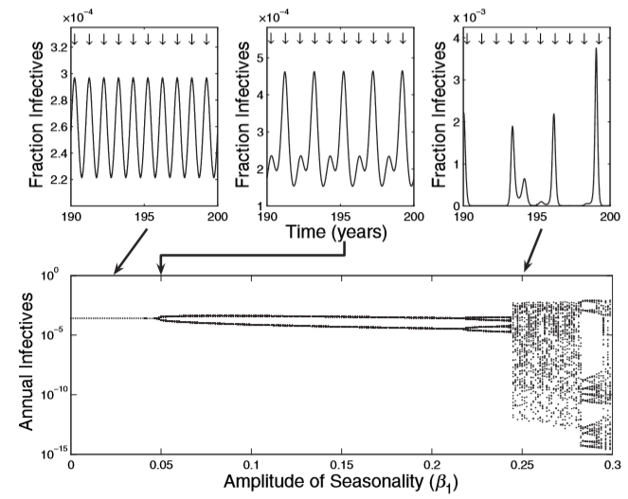
Bifurcation Diagrams Can Show How the Periodicity (or Chaotic Nature) of the System Depends on Parameters (Beta1)

Slide 49
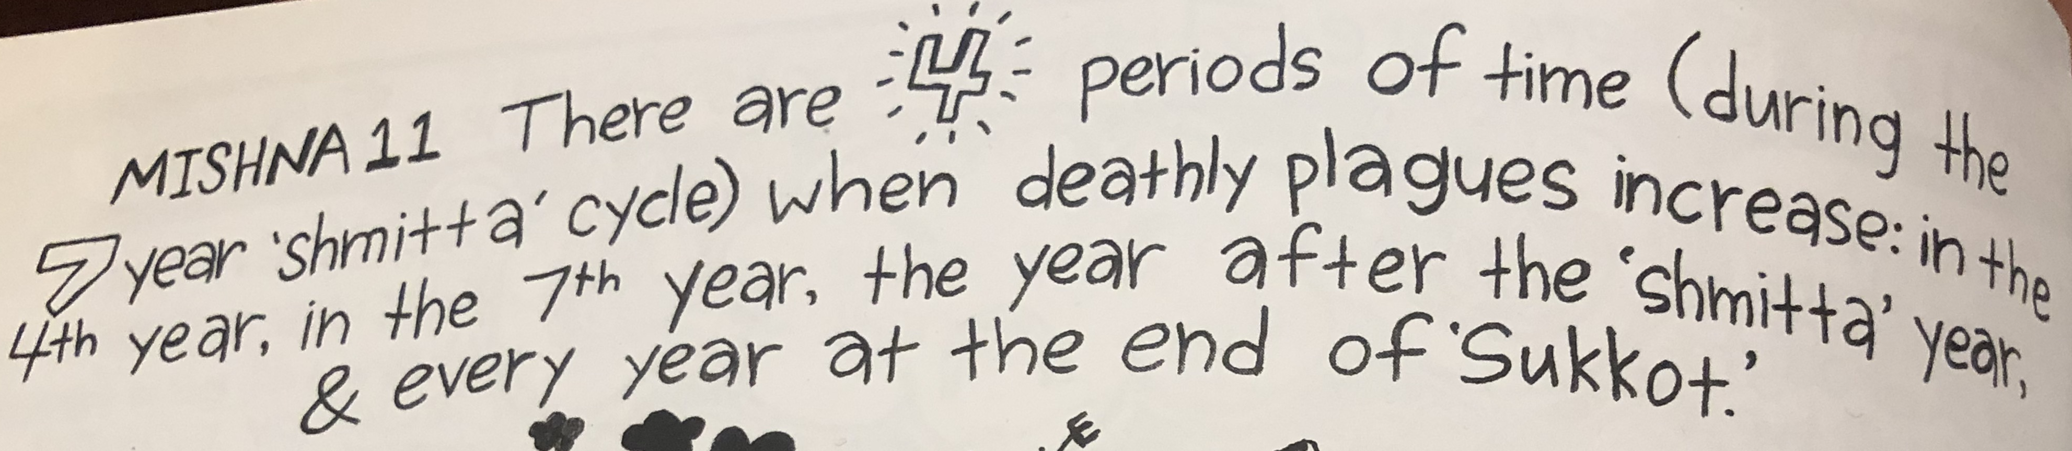
People were aware of these phenomena a long time ago
Misha ~450 BCE
3 deathly plague years during the 8-year (shmitta) cycle:
What is the periodicity?
Annual plagues that occur at a specific time of year (Sukkot) right after people would congregate as a pilgrims, coming from many places and live in little outdoor booths for a week in Jerusalem
Can we expect certain years to be particularly bad plagues? Why?

Slide 50
Important Announcements

